Slide 1
Graph theory
Graphs
You have seen some graphs
  Trees are graphs
  Linked lists are (simple) graphs
Parsing uses graph theory
  Maintain state using a graph
What is graph theory?

Slide 2
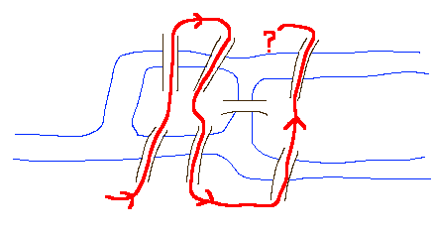
Graph theory: Königsberg
Königsberg (in Germany) had seven bridges. The townspeople wondered if was possible to take a walk around the town in such a way as to cross each of the seven bridges exactly once.
Notes:
Oldest known graph theory problem
Euler in 1736

Slide 3
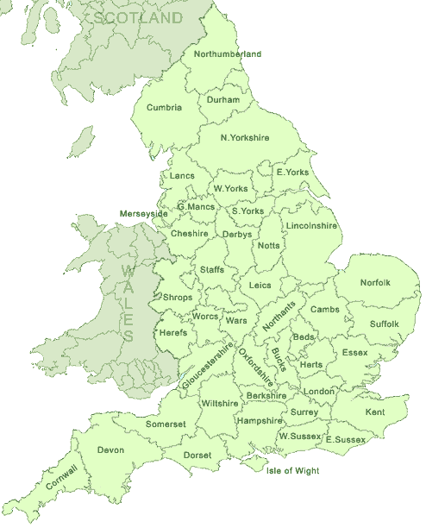
Graph theory: map colouring
How many colors do we need to color a map so that every pair of counties with a border in common have different colors?

Slide 4
Graphs
A graph is a set of nodes connected by arcs
  Directed graph if the arcs have direction
  Undirected graph if the arcs simply show connection
There are lots of graphs in this world:
  Bus routes
  Transitions in a finite state machine
  Course prerequisites
Kind of odd that java.util.Graph doesn’t exist

Slide 5
Example
Key | Value
A | {D, B, C}
B | {D, E}
C | {}
D | {F}
E | {F, G}
F | {}
G | {}
A
B
C
D
E
F
G

Slide 6
Graph algorithms
Crop up everywhere in computing
Most are recursive
Must handle circularity
Common solution is to keep track of nodes already visited using a set
B
A
C

Slide 7
Example: Reachability
Can we get to E from A?
B
A
C
D
E

Slide 8
Example: Reachability
  For each child of the src, check if dst is reachable from that child
B
A
C
D
E
src: A
seen:
{}
Notes:
First call:
for each arc in set associated with A
if not dest, call reachable

Slide 9
Example: Reachability
B
A
C
src: B
seen:
D
E
src: A
seen:
{A}
Notes:
First call:
for each arc in set associated with A
if not dest, call reachable

Slide 10
Example: Reachability
B
src: C
seen:
A
C
src: B
seen:
D
E
src: A
seen:
{A,B}
Notes:
First call:
for each arc in set associated with A
if not dest, call reachable

Slide 11
Example: Reachability
B
B
src: C
seen:
A
A
C
C
src: B
seen:
D
D
E
src: A
seen:
{A,B,C}
Notes:
First call:
for each arc in set associated with A
if not dest, call reachable

Slide 12
Example: Reachability
B
A
C
src: D
seen:
D
E
src: A
seen:
{A,B,C}
Notes:
First call:
for each arc in set associated with A
if not dest, call reachable

Slide 13
Shortest Path
What is the shortest path from A to E?
B
A
C
E
D

Slide 14
Shortest Path
src: C
seen:
len: 3
B
B
src: B
seen:
len: inf
A
A
C
C
E
src: A
seen:
len: inf
D
{A}
{A,B}
{A,B,C}

Slide 15
Shortest Path
B
B
src: B
seen:
len: 3
A
A
C
E
src: A
seen:
len: 3
src: A
seen:
len: inf
D
{A}
{A,B,C}

Slide 16
Shortest Path
Problem! Can’t just keep adding nodes to the seen set.
B
src: D
seen:
len: 3
A
C
E
src: A
seen:
len: 3
D
{A}
{A,B,C}

Slide 17
Design choices
Three basic representations:
  Graph object contains nodes and arcs
  Graph object contains nodes, node objects contain arcs
  Graph object contains arcs, arc objects contain nodes
Each one makes some algorithms cheap and others expensive

Slide 18
Making a choice
Today, graphs are stored as maps
Keys are the names of nodes
Values are the set of nodes
  A node B is in the set of nodes for node A if there is an arc from A to B

Slide 19
Graphs
class DirectedGraph {
public DirectedGraph() {...}
public Set getNodes() {...}
public boolean hasNode(Object node) {...}
public void addNode(Object node) {...}
public void addNode(Object node, Collection arcs) {...}
public void removeNode(Object node) {...}
public Set getArcs(Object node) {...}
public boolean hasArc(Object src, Object dst) {...}
public void addArc(Object src, Object dst) {...}
public void addArcs(Object src, Collection allDst) {...}
public void removeArc(Object src, Object dst) {...}
public String toString() {...}
protected Map m_nodes;
}

Slide 20
More design choices
What happens if we try to add a node that is already present?
  Or duplicate an arc?
  Or remove a node or arc that doesn’t exist?
Could throw an exception
  Means that users have to write code like
    if (not present) then add node
Could just ignore operations that don’t make sense
  Results in late failures

Slide 21
Still more design choices
What should a graph return when asked for its nodes?
  Return a map’s keys as a set
What if it is asked for a node’s arcs?
  The set used to store the arcs?
    Efficient, but allows users to mess up data structure
  A copy of the set?
    Less efficient for large graphs with many arcs, but safer
What if a user wants all arcs?
  Not directly available, but easy to construct
    A set or a list of two-element lists (arrays)?

